Slide 1
Session #5: Comparing Architectures
Thursday, Sept 8
CSCI 601.771: Self-supervised Statistical Models

Slide 2

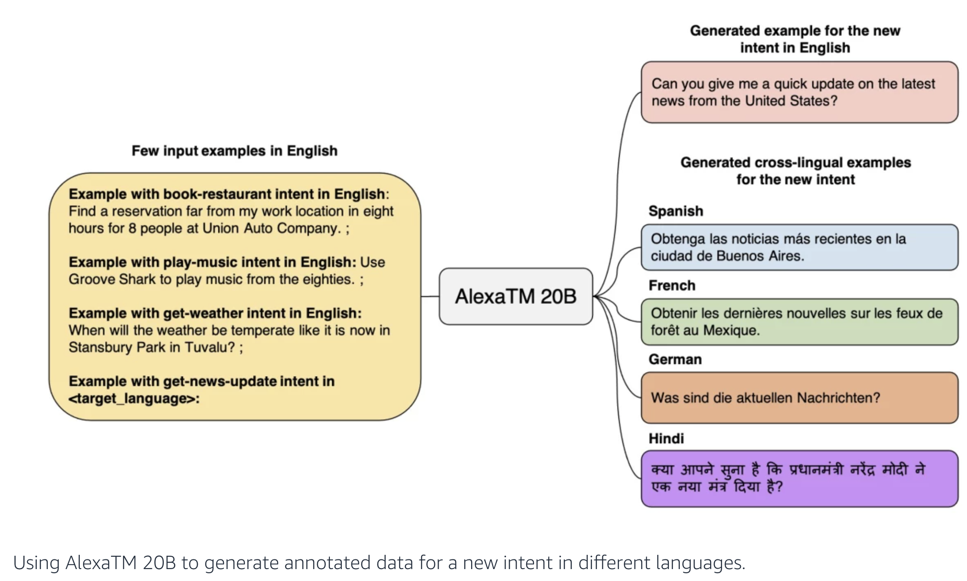
News: 20B-parameter Alexa model
"With an encoder-decoder architecture — rather than decoder only — the Alexa Teacher Model excels other large language models on few-shot tasks such as summarization and machine translation."
https://www.amazon.science/blog/20b-parameter-alexa-model-sets-new-marks-in-few-shot-learning?utm_source=email&utm_medium=newsletter&utm_campaign=science_news&utm_term=august_2022&utm_content=20B-parameter&mkt_tok=MzIzLU1GUi01NjgAAAGGj9mj5p7IZnN1QvKvIUlieyofI2txXmQLKXbjCtGejsnWt9FtUhlWH9wDIvpVhUZtWkm8Z2AYkmnVnJ1-XsV7hkVgZ0BKfn01xY4

Slide 3
Week's prompt
This would have been a much better paper if ____

Slide 4
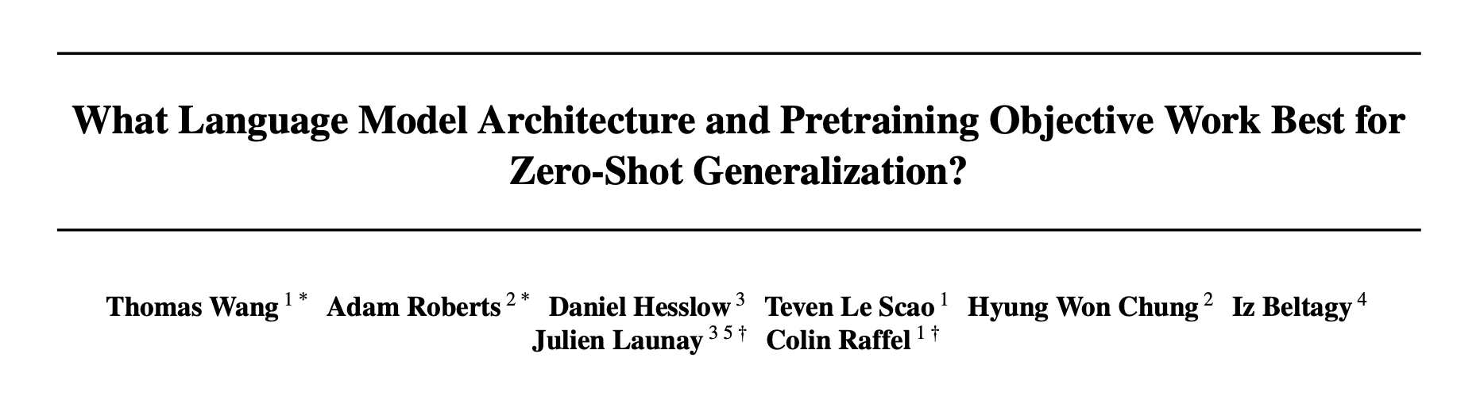
By: Ayo Ajayi and Muhannad Muzammil Godil
✍️: Ayo Ajayi and Muhannad Muzammil Godil

Slide 5
Zero-shot Generalization
What is Zero-shot Generalization?
✍️: Ayo Ajayi and Muhannad Muzammil Godil
Source

Slide 6
Zero-shot Generalization
What is Zero-shot Generalization?
“Zero-shot” allows a model to recognize what it hasn’t seen before.
✍️: Ayo Ajayi and Muhannad Muzammil Godil
Source

Slide 7
Zero-shot Generalization
What is Zero-shot Generalization?
“Zero-shot” allows a model to recognize what it hasn’t seen before.
The capability of large language models pretrained on unstructured data to perform tasks without additional training.
The ability of large language models to perform a wide variety of tasks that they were not explicitly trained on.
✍️: Ayo Ajayi and Muhannad Muzammil Godil
Source

Slide 8
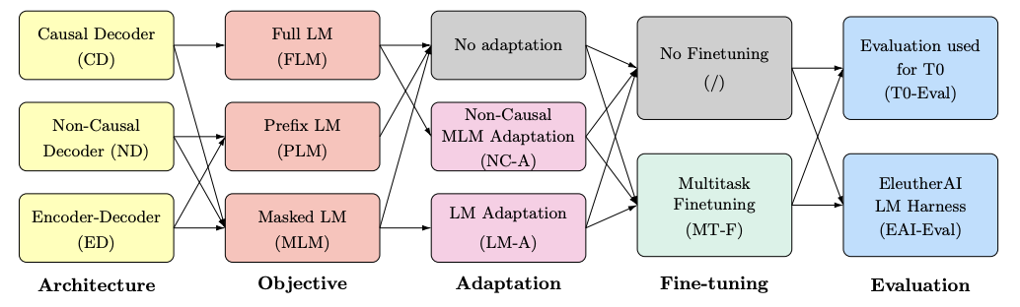
Motivation
What is the perfect formula for attaining zero-shot generalization?
✍️: Ayo Ajayi and Muhannad Muzammil Godil

Slide 9
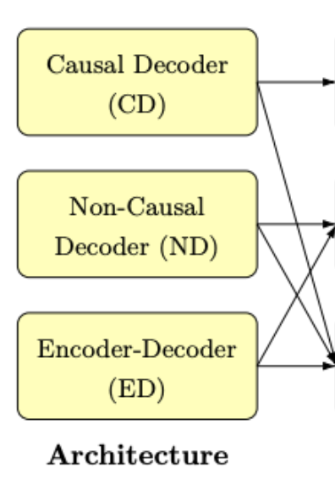
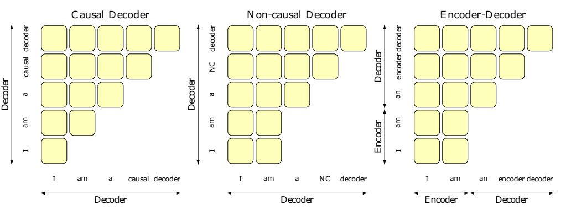
Architecture
Attention is allowed to be bidirectional on any conditioning information
Attention is allowed to be bidirectional on any conditioning information fed into the encoder.
Each token attends to previous tokens only
✍️: Ayo Ajayi and Muhannad Muzammil Godil

Slide 10
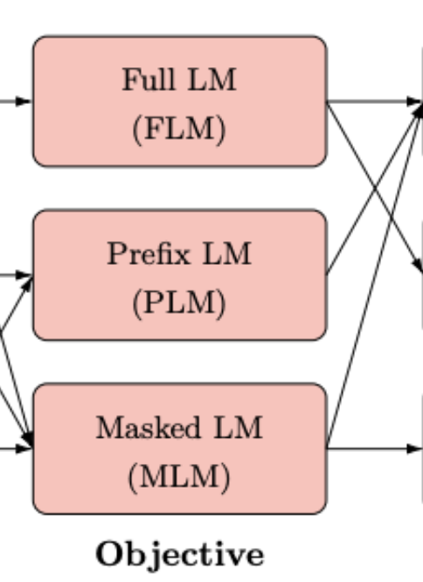
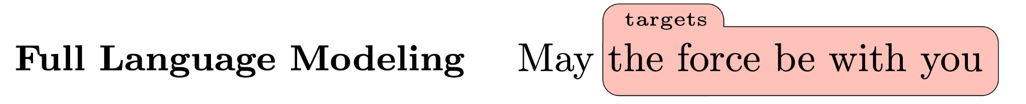
Objective
Given previous tokens, the model is tasked with predicting the following one. Large decoder-only models.
✍️: Ayo Ajayi and Muhannad Muzammil Godil
Notes:
Full Langauge modeling
Prefix Language Modeling
Masked Language Modeling

Slide 11
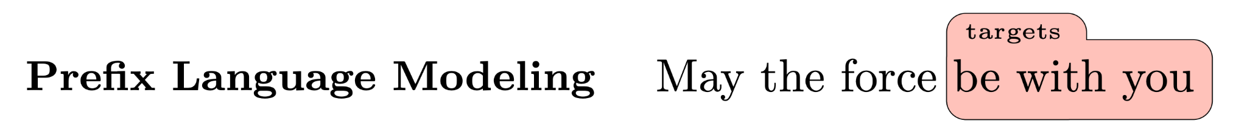
Objective
Given previous tokens, the model is tasked with predicting the following one. Large decoder-only models.
Predict each token outside the prefix given all previous tokens. Encoder-decoder and non-causal decoder-only models.
✍️: Ayo Ajayi and Muhannad Muzammil Godil
Notes:
Full Langauge modeling
Prefix Language Modeling
Masked Language Modeling

Slide 12
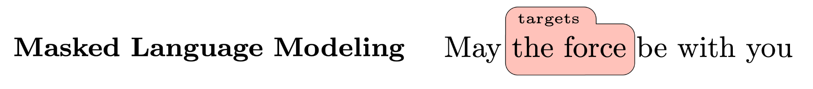
Objective
Given previous tokens, the model is tasked with predicting the following one. Large decoder-only models.
Predict each token outside the prefix given all previous tokens. Encoder-decoder and non-causal decoder-only models.
Replacing certain tokens with a mask. Encoder-only Models.
Notes:
Full Langauge modeling
Prefix Language Modeling
Masked Language Modeling

Slide 13
Objective - Modeling Configuration
For full language modeling, all tokens in a sequence are used during training.
For prefix language modeling, we randomly select a prefix size, and hence only half of the tokens are used on average to derive the loss.
For masked language modeling, we mask 15% of the tokens, in spans of 3 tokens on average.
✍️: Ayo Ajayi and Muhannad Muzammil Godil

Slide 14
Self-Supervised Learning
Self-supervised learning is a machine learning process where the model trains itself to learn one part of the input from another part of the input. It is also known as predictive or pretext learning.
✍️: Ayo Ajayi and Muhannad Muzammil Godil

Slide 15
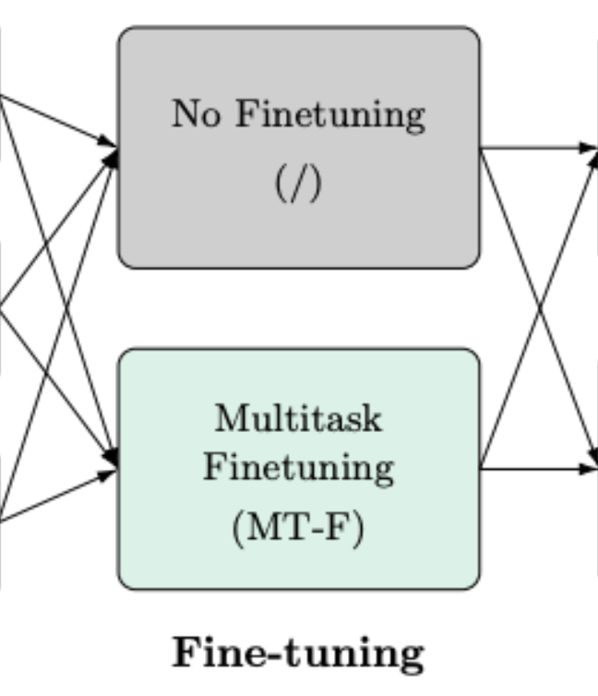
Multitask Fine-tuning
Recent work shows that multitask fine-tuning improves zero-shot performance.
Multitask Fine-tuning: fine-tuning the model on a dataset of prompted tasks.
Explicitly fine-tune the model to solve different tasks.
✍️: Ayo Ajayi and Muhannad Muzammil Godil

Slide 16
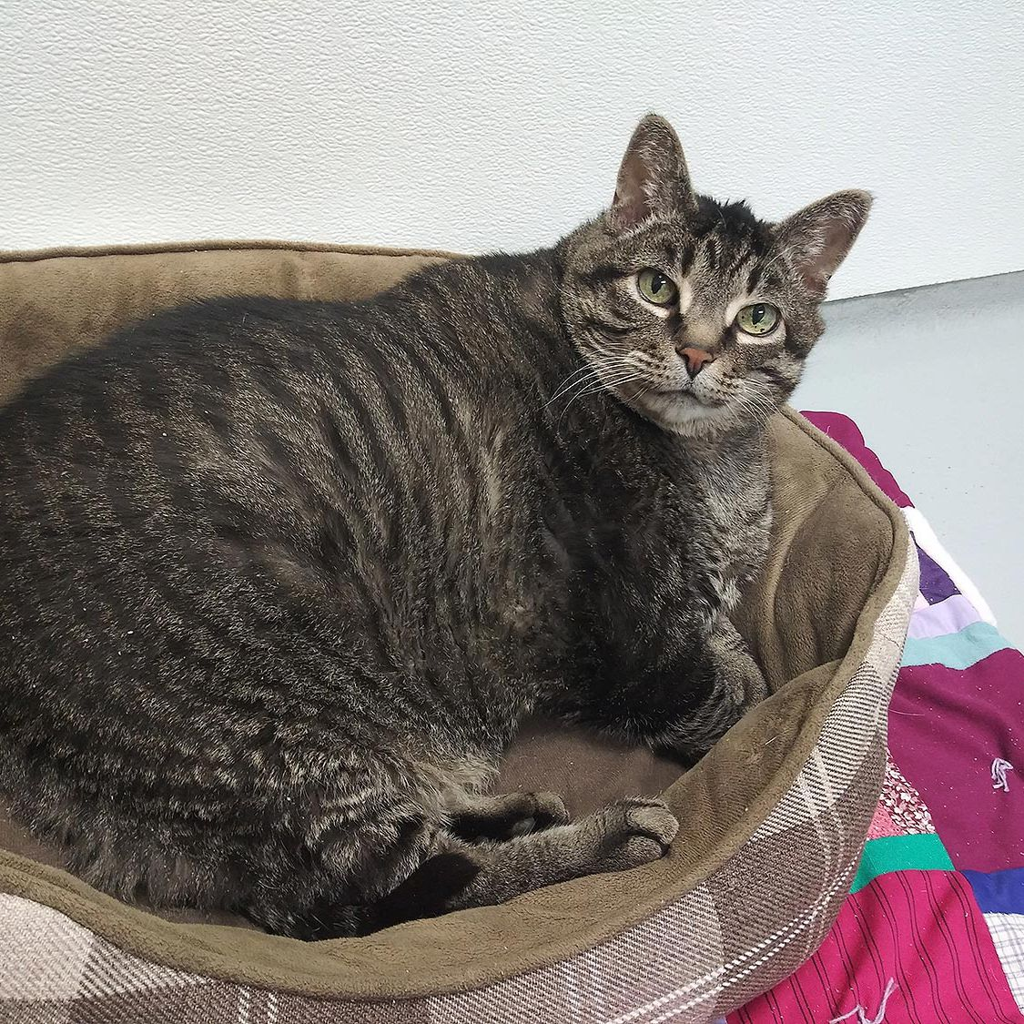
All previously mentioned architecture was trained on 168 billion tokens
Multitask fine tuning is then considered and evaluation is done on zero shot performance
The training budget was similar across all models 15 petaflops-days over 830,000 TPUv4 hours
Method

Slide 17

Results:
We use 2 zero-shot benchmarks to evaluate our training T0-Eval & EAI-Eval
T0-Eval provides multiple prompts per task vs EAI-Eval which provides 1 prompt per task
✍️: Ayo Ajayi and Muhannad Muzammil Godil

Slide 18
T0 And EAI
T0 was just a model that was evaluated for a set of tasks in 2021 (Sanh ,2021)
We use the same set of tasks which is why it is called T0-Eval
EAI - Eval uses just 1 prompt per task it has 200 + tasks available to test AR models on
The main difference is that T0 provides multiple prompts per task while EAI gives one
✍️: Ayo Ajayi and Muhannad Muzammil Godil

Slide 19
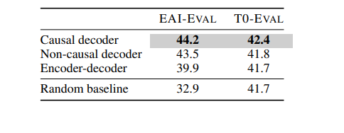
Self supervised pre-training
Causal decoder-only models pretrained with a full language modeling objective achieve best zero-shot generalization when evaluated immediately after self-supervised pre-training.
✍️: Ayo Ajayi and Muhannad Muzammil Godil

Slide 20
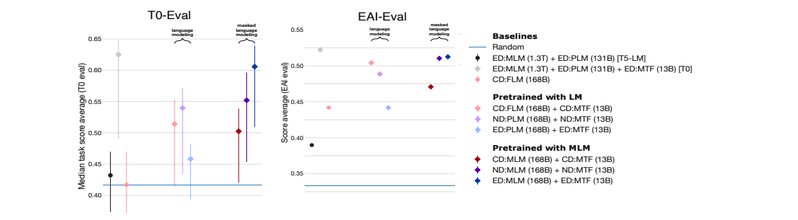
After Multi Task fine tuning
Encoder-decoder models pretrained with masked language modeling achieve the best zero-shot performance after multitask finetuning .
✍️: Ayo Ajayi and Muhannad Muzammil Godil

Slide 21
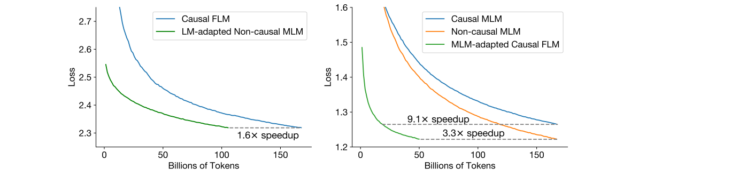
Adaptation from architectures
Decoder-only models can be efficiently adapted from one architecture/objective prior to the other. Specifically, we recommend starting with a causal decoder-only model, pretraining it with a full language modeling objective, and then using non-causal masked language modeling adaptation b
Decoder-only models can be efficiently adapted from one architecture/objective prior to the other. Starting with a causal decoder-only model, pretraining it with a full language modeling objective, and then using non-causal masked language modeling adaptation before taking it through multitask fine tuning .

Slide 22
Positive
🟢 Systematic empirical investigation of Language Modelling choices
🟢 Actionable takeaways that anyone using these models can benefit from
🟢 Interesting experiments in adaptation between architecture and objectives
🔍: Isabel, Karan

Slide 23
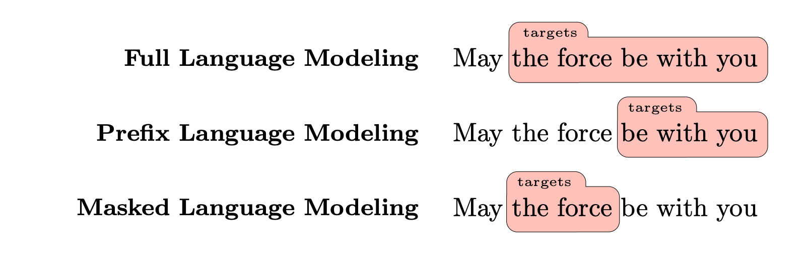
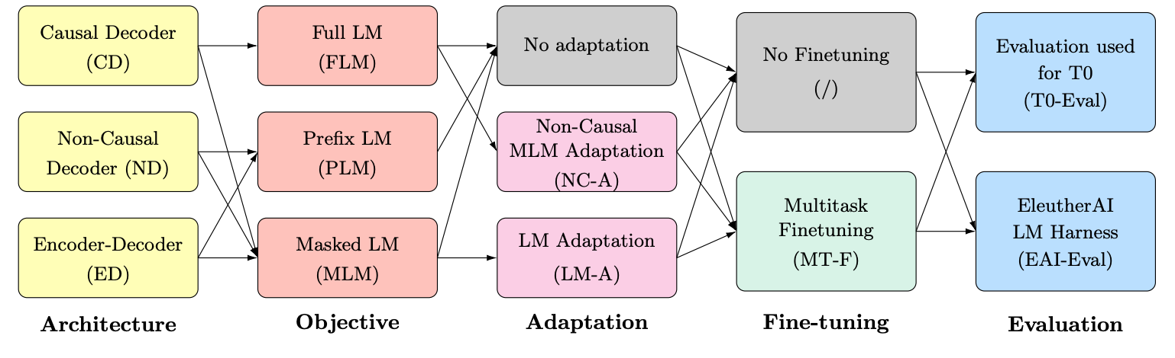
Positive
🟢 Release of code and model benchmarks
🟢 Clear writing and visualizations
🔍: Isabel, Karan

Slide 24
Potential Caveats
🟡 Can only do so many ablations with a limited budget
E.g. no discussion of effects of hyperparameter choices, non-linearity functions, etc
🟡 Unclear if these experiments generalize to larger models
🟡 No breakdown of each individual task within the benchmarks, only averages across tasks
No statistical analysis or hypothesis testing
🔍: Isabel, Karan

Slide 25
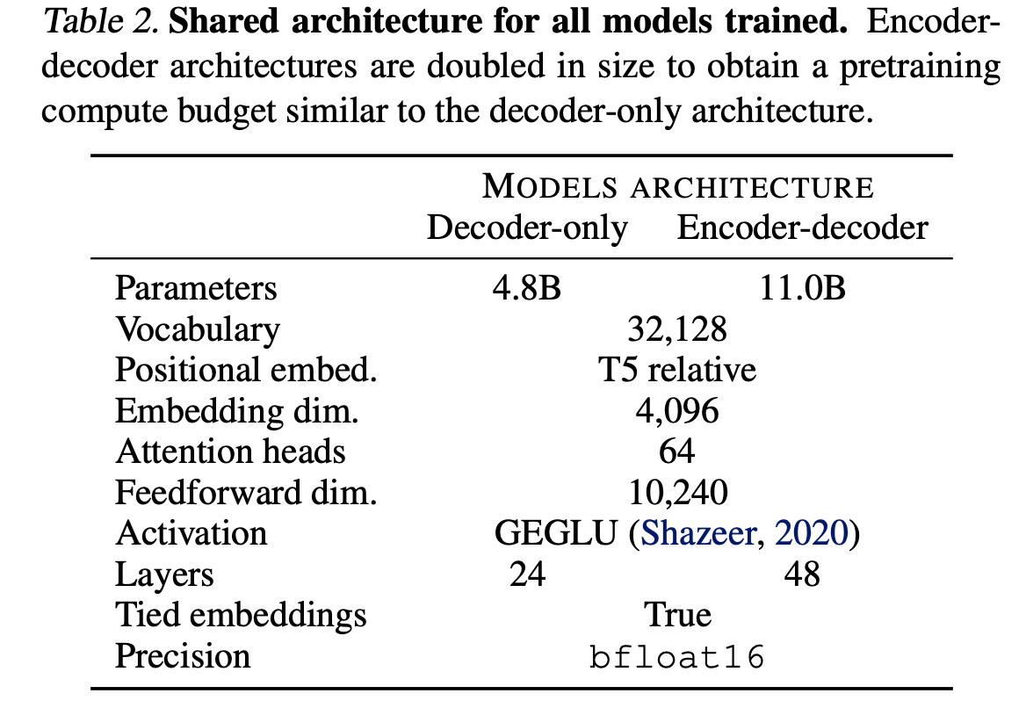
Potential Caveats
🟡 Not clear why the compute budget was chosen to remain constant as opposed to overall model size or decoder size
🟡 Not including encoder models for adaptation
encoder-decoder -> causal decoder (mentioned)
encoder-decoder -> encoder (not mentioned)
Mentioning it would answer “How important is Encoder vs Decoder information in context of Zero Shot learning?”
🔍: Isabel, Karan

Slide 26
Empiricists
CD(GPT) vs. ED(BART)
Yongrui Qi & Fadil Isamotu

Slide 27
pretrained Only
👩🏽‍🔬: Yongrui, Fadil

Slide 28
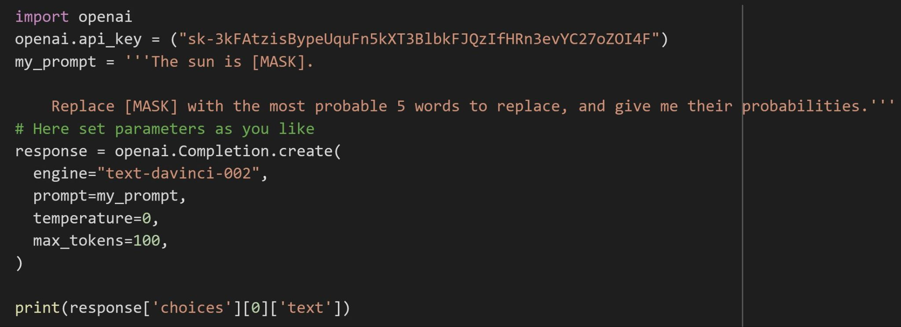
Mask Filling: Prompt → “The sun is <mask>. ”
GPT3

Slide 29
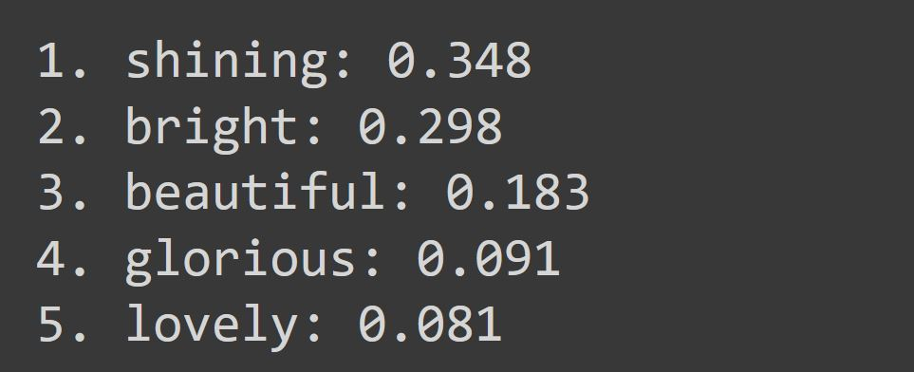
Result:

Slide 30
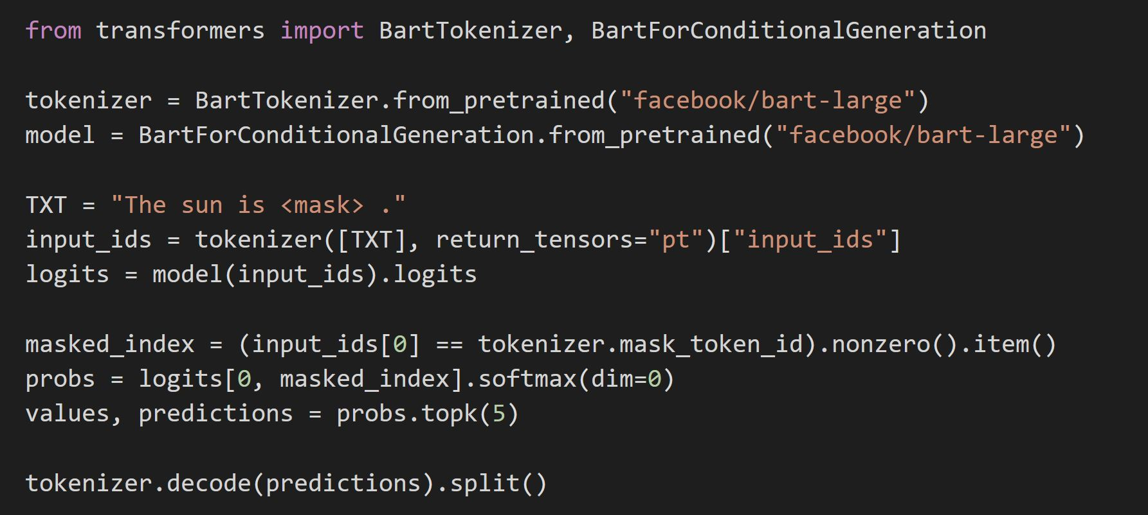
Result:
BART

Slide 31
Text Generation: Prompt→ I enjoy walking with my cute dog, …
BART:
[{'generated_text': 'I enjoy walking with my cute dog, should should just should should shouldto shouldBar justERAJusttoBarBar justtoBar justBarBar'}]
GPT2:
[{'generated_text': 'I enjoy walking with my cute dog, which has a little tendency to bite my paws!"\n\n(Photos by David Evans Photography)'}]
GPT3:
[{'generated_text': 'I enjoy walking with my cute dog, because it relaxes me.'}]

Slide 32
After multitask finetuning

Slide 33
Summarization: prompt’s word count = 327
The early decades of the 21st century saw expansion across the university's institutions in both physical and population sizes. Notably, a planned 88-acre expansion to the medical campus began in 2013. Completed construction on the Homewood campus has included a new biomedical engineering building in the Johns Hopkins University Department of Biomedical Engineering, a new library, a new biology wing, an extensive renovation of the flagship Gilman Hall, and the reconstruction of the main university entrance. These years also brought about the rapid development of the university's professional schools of education and business. From 1999 until 2007, these disciplines had been joined within the School of Professional Studies in Business and Education (SPSBE), itself a reshuffling of several earlier ventures. The 2007 split, combined with new funding and leadership initiatives, has led to the simultaneous emergence of the Johns Hopkins School of Education and the Carey Business School. On November 18, 2018, it was announced that Michael Bloomberg would make a donation to his alma mater of $1.8 billion, marking the largest private donation in modern history to an institution of higher education and bringing Bloomberg's total contribution to the school in excess of $3.3 billion. Bloomberg's $1.8 billion gift allows the school to practice need-blind admission and meet the full financial need of admitted students. In January 2019, the university announced an agreement to purchase the Newseum, located at 555 Pennsylvania Ave. NW, in the heart of Washington, D.C., with plans to locate all of its D.C.-based graduate programs there. In an interview with The Atlantic, the president of Johns Hopkins stated that “the purchase is an opportunity to position the university, literally, to better contribute its expertise to national- and international-policy discussions.” In late 2019, the university's Coronavirus Research Center began tracking worldwide cases of the COVID-19 pandemic by compiling data from hundreds of sources around the world. This led to the university becoming one of the most cited sources for data about the pandemic.

Slide 34
BART
Result: Word count = 42
The early decades of the 21st century saw expansion across the university's institutions. A planned 88-acre expansion to the medical campus began in 2013. In January 2019, the university announced an agreement to purchase the Newseum, located at 555 Pennsylvania Ave. NW.

Slide 35
GPT2
Result: Word count = 148
The early decades of the 21st century saw expansion across the university's institutions in both physical and population sizes. Notably, a planned 88-acre expansion to the medical campus began in 2013. Completed construction on the Homewood campus has included a new biomedical engineering building in the Johns Hopkins University Department of Biomedical Engineering, a new library, a new biology wing, an extensive renovation of the flagship Gilman Hall, and the reconstruction of the main university entrance. These years also brought about the rapid development of the university's professional schools of education and business. From 1999 until 2007, these disciplines had been joined within the School of Professional Studies in Business and Education (SPSBE), itself a reshuffling of several earlier ventures. The 2007 split, combined with new funding and leadership initiatives, has led to the simultaneous emergence of the Johns Hopkins School of Education and the Carey Business School….

Slide 36
GPT3
Result: Word count = 43
Johns Hopkins University is a private research university in Baltimore, Maryland. Founded in 1876, the university was named for its first benefactor, the American entrepreneur, abolitionist, and philanthropist Johns Hopkins. His $7 million bequest (approximately $144.5 million in today's dollars)—of which half

Slide 37
Archaeologist
Putting things in the context of the literature …
🏺: Haoyue, Ha

Slide 38
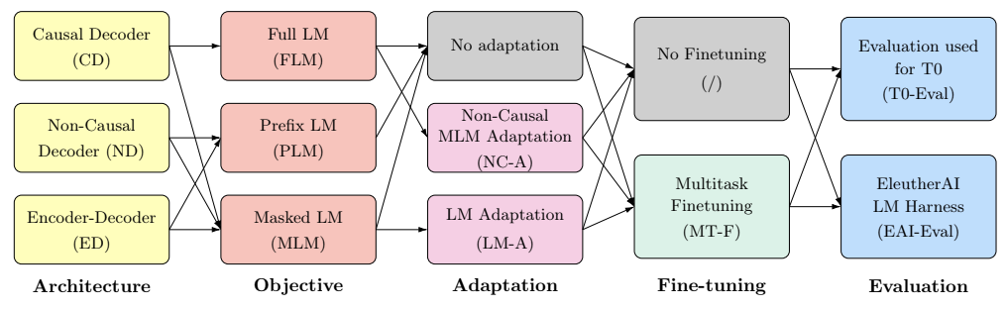
Large Language Models in zero-shot generalization overview
Overview components of Large Language Models (LLM) in zero-shot generalization:
Pretraining Objective: Self-supervised training technique for LLM
Architecture: Backbone corresponds to objective
Adaptation: Add pretraining data after casting/converting architecture
Fine-tuning: Update model parameter
Evaluation: Evaluate zero-shot generalization
=> Relationship between components matters in generalization evaluation!
🏺: Ha, Haoyue
Wang et. al., 2022: What Language Model Architecture and Pretraining Objective Work Best for Zero-Shot Generalization?

Slide 39
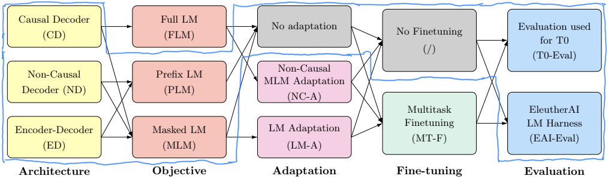
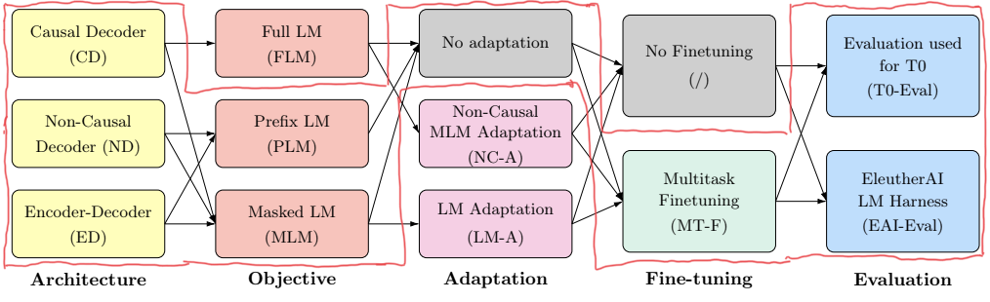
Prior works
Raffel et. al., 2020: shows that encoder-decoder models outperform decoder-only LLMs for transfer learning
Sanh et. al., 2021: concludes multitask finetuned encoder-decoder LLM outperforms decoder-only models on zero-shot generalization
etc.
Problem: Prior works only consider a small part of the picture => Unfair comparison
Motivation: What we need is results on all possible paths of this directed graph!
Raffel
Sanh
🏺: Ha, Haoyue

Slide 40
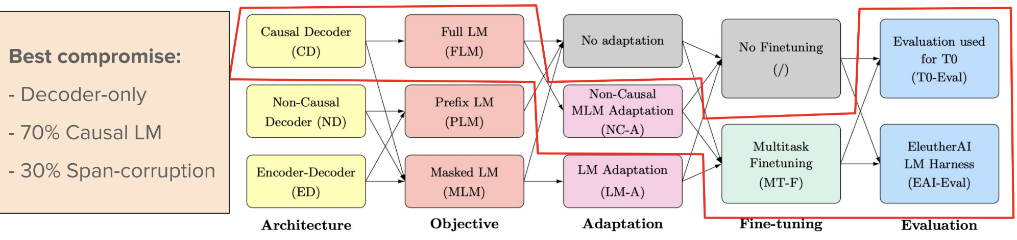
Wang’s finding
Wang et. al., 2022: What Language Model Architecture and Pretraining Objective Work Best for Zero-Shot Generalization?
ACL 2022 Tutorial: Zero- and Few-Shot NLP with Pretrained Language Models
🏺: Ha, Haoyue

Slide 41
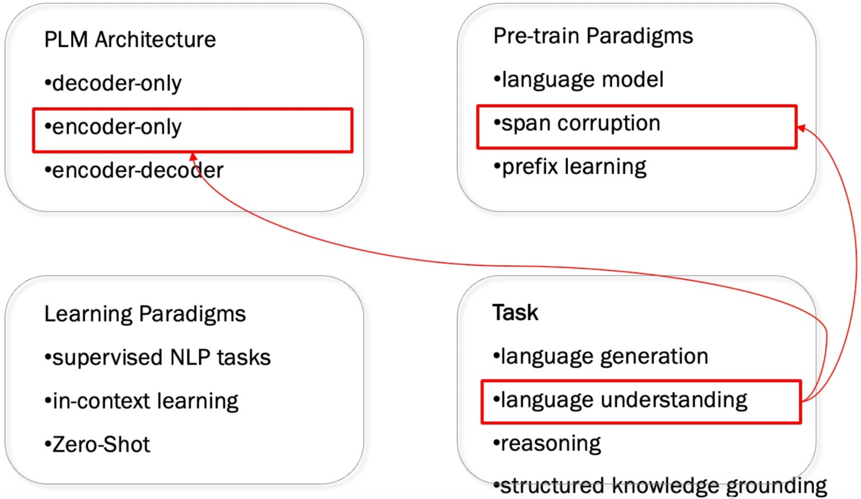
Rethinking the current fine-tuning method
We have a variety of pre-training paradigms:
🏺: Ha, Haoyue

Slide 42
Rethinking the current fine-tuning method
Different paradigms model different contextual relationships.
Because of the method above, different pre-training paradigms are adapted to different types of downstream tasks.
e.g. span corruption (T5) is more applicable to fact completion.
PrefixLM/LM (GPT) is more suitable for open ended.
Problem:
Specific pre-training strategies need to be chosen for specific downstream task types!
Deploying specific models for different downstream tasks is very resource-intensive!
🏺: Ha, Haoyue

Slide 43
Subsequent Work
Tay, Yi, et al. 2022 "Unifying Language Learning Paradigms." : What we need is a unified large model!
Motivation: Construct a pre-training strategy that is independent of the model architecture, and can be flexibly adapted to different types of downstream tasks.
Why?
With a unified model, it is possible to focus on improving and extending individual models.
It is desirable to have a pre-trained model that can perform well on multiple tasks. (Resource is limited, takes long time to train PLM)
🏺: Ha, Haoyue

Slide 44
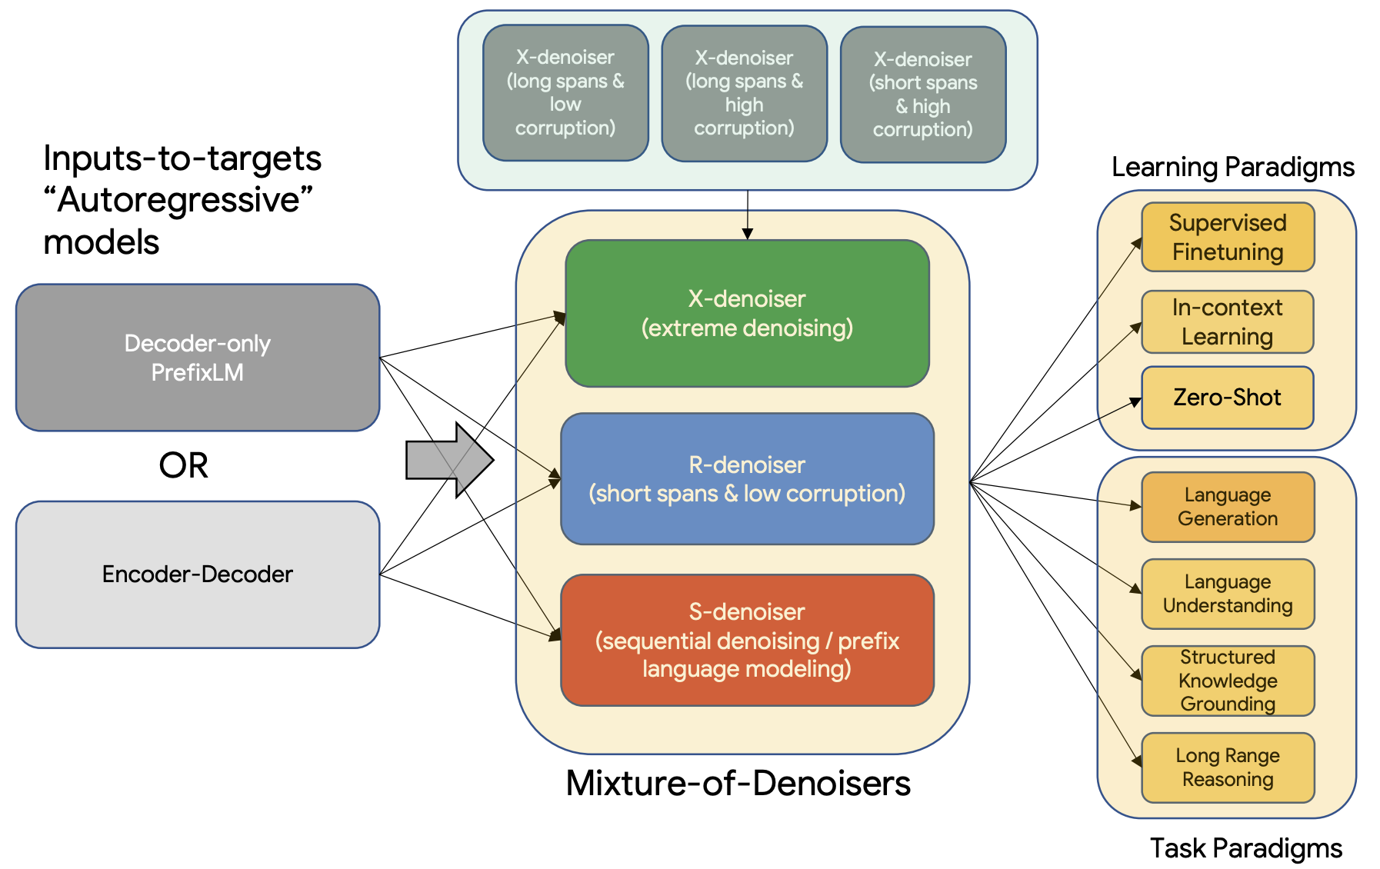
Subsequent Work
Tay, Yi, et al. 2022: Unifying Language Learning Paradigms.
🏺: Ha, Haoyue

Slide 45
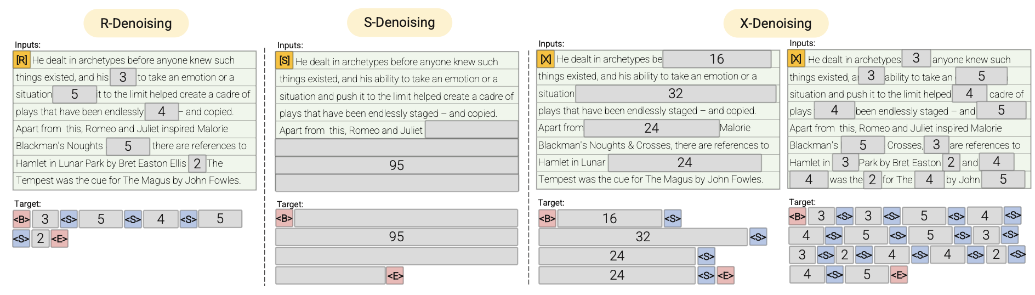
Subsequent Work
R-Denoiser : regular denoising. Is the T5 span corruption objective.
S-Denoiser : sequential denoising. Is connected to causal language models that are GPT-like.
X-Denoiser : extreme denoising. Can expose the model to a combination of objectives from T5 and Causal LMs.
Tay, Yi, et al. 2022: Unifying Language Learning Paradigms.
🏺: Ha, Haoyue
Notes:
R-Denoiser : Usually used to gain knowledge rather than the ability to generate fluent text.
S-Denoiser : Typically used for inputs-to-targets tasks.
X-Denoiser : Can be seen as an intermediate between R-denoiser and S-denoiser. It is generally used for long text generation tasks

Slide 46
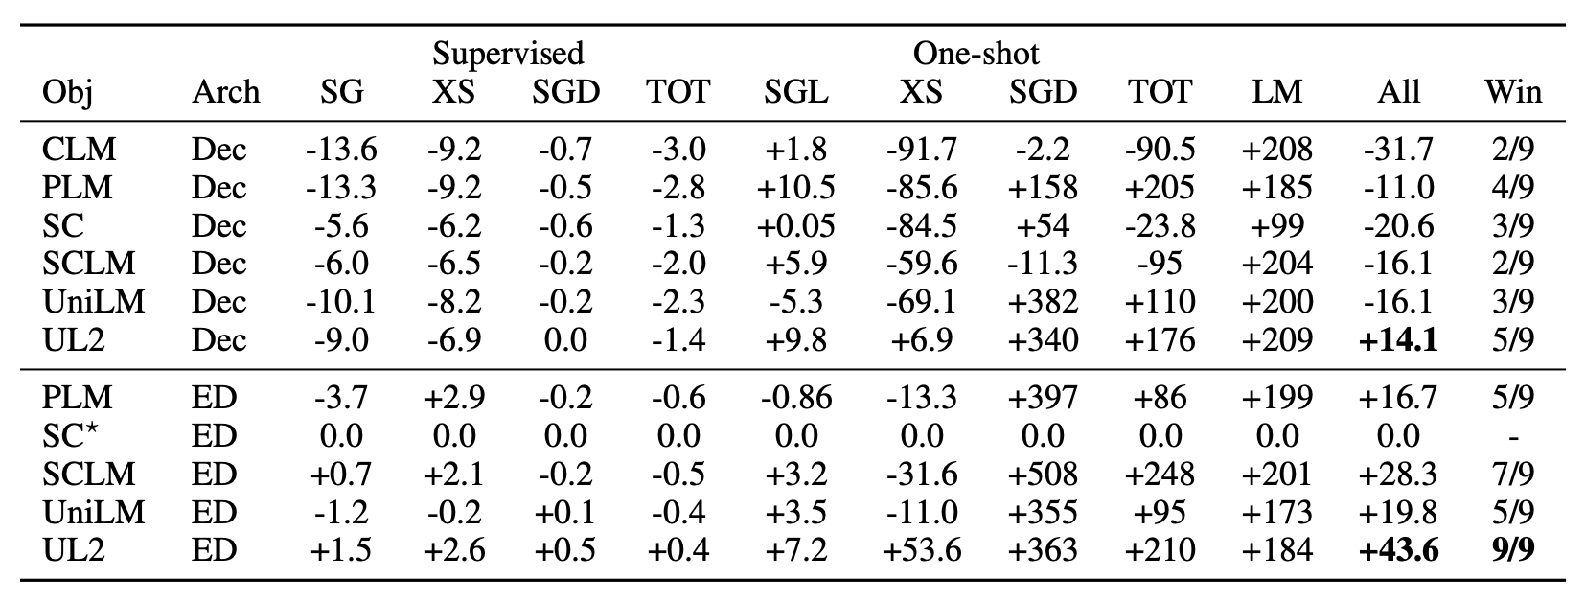
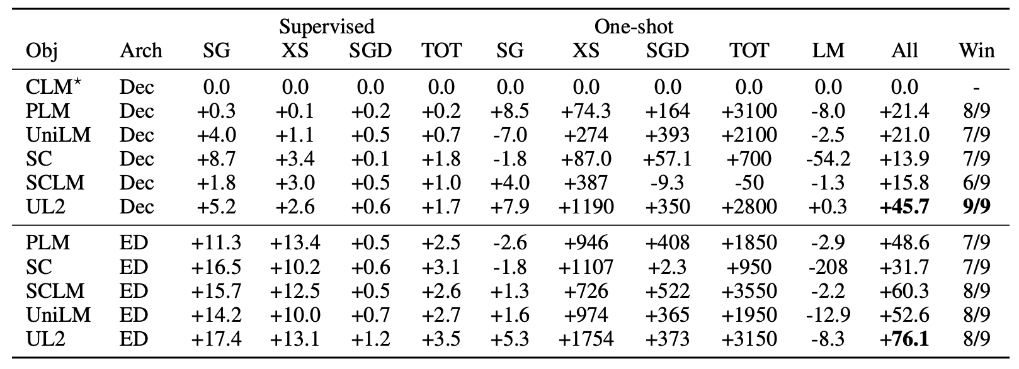
Relative performance compared to standard encoder-decoder span corruption model (T5).
Relative performance compared to standard decoder causal language model (GPT-like)
🏺: Ha, Haoyue

Slide 47
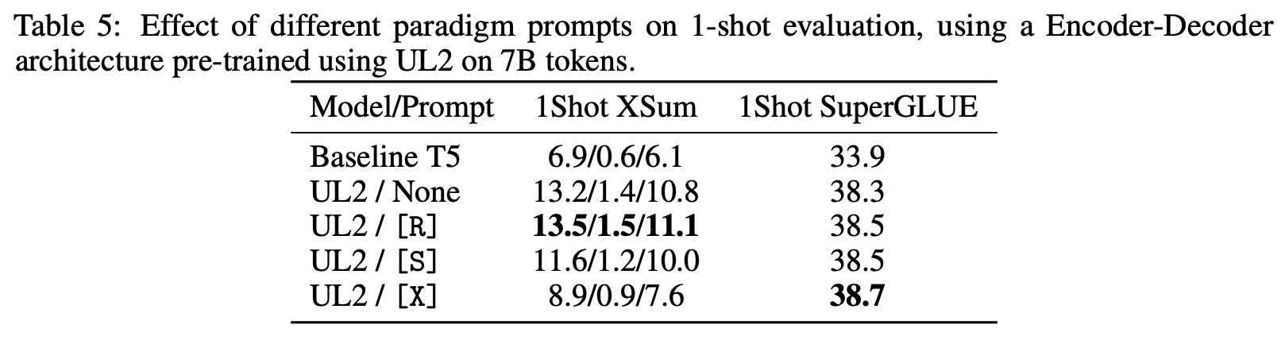
Experiments
In one-shot scenarios, it is almost always better to use paradigm prompts, but it is critical to pick the right one.
🏺: Ha, Haoyue

Slide 48
Visionary Interpretation
Ammar
Elisée
🔭: Ammar, Elisee

Slide 49
Paper Approach
The paper tested multitask finetuning with three model architectures and two different types of pretraining objectives.
The authors suggest that other architectures can be tried out, like sparsely gated mixture of experts.
We want to try a different solution approach with images, since this paper talks more regarding text
🔭: Ammar, Elisee

Slide 50
Application on Images
Comparison of architectures and objectives for images
VAEs and GANs can be considered for the generation block in the architecture
Zero-Shot Text to Image Generation, 2021 ICML
https://arxiv.org/pdf/2102.12092.pdf
Uses VAE to generate images
Limitation: Lack of proven options to compare in zero shot image generation, unlike text
🔭: Ammar, Elisee
Notes:
Models that create images

Slide 51
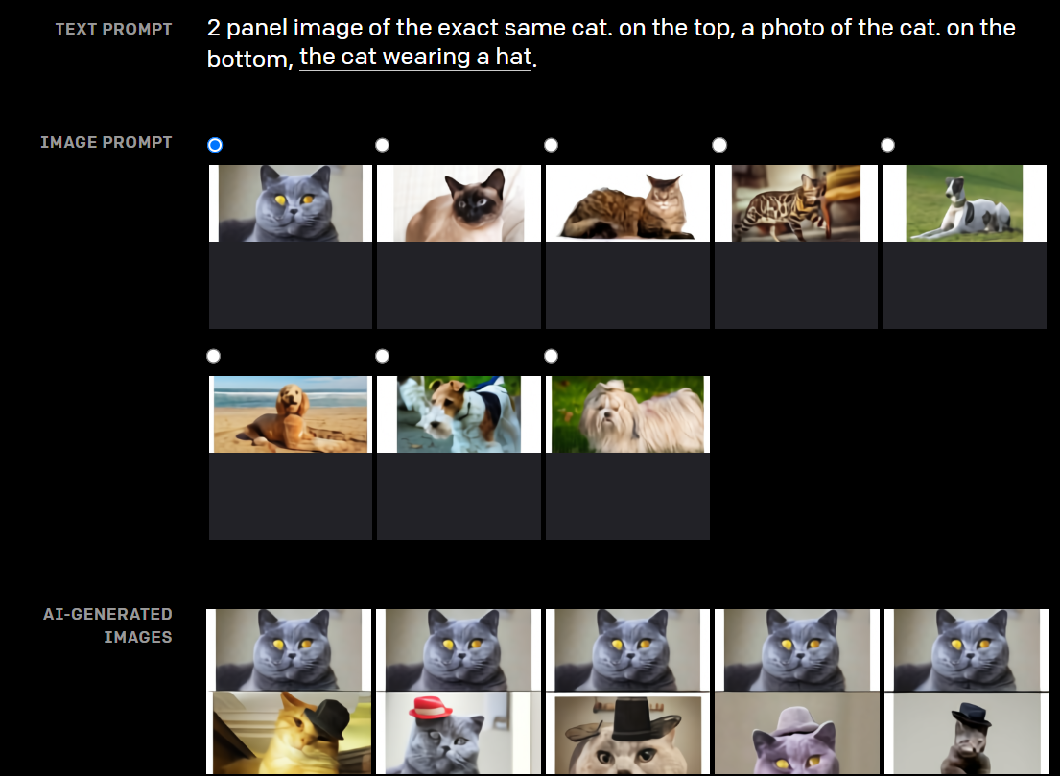
DALL-E
🔭: Ammar, Elisee

Slide 52
Complimentary Work
Using DeepSpeed and Megatron to Train Megatron-Turing NLG530B, A Large-Scale Generative Language Model
Microsoft DeepSpeed deep learning optimization library
NVIDIA Megatron-LM large transformer model
Training of the largest monolithic transformer-based language model, Megatron-Turing NLG 530B (MT-NLG),with 530 billion parameters.
🔭: Ammar, Elisee

Slide 53
Complimentary Work
Will help further with development of large-scale training infrastructures, large-scale language models, and natural language generations.
which achieves superior zero-, one-, and few-shot learning accuracies and new state-of-the-art results on NLP benchmarks.
🔭: Ammar, Elisee

